Slide 1
Cs5319 Final Presentation
Fernando Corral

Slide 3
Canceled
Web Application
Utilizing Flask (Python) library, Bootstrap CSS Styling, MongoDB
Account Creation and Editing
Adding, accepting, and removing friends
Create and delete Requests
Requests update on software interaction with friends

Slide 4
Client – Server Architecture

Slide 5
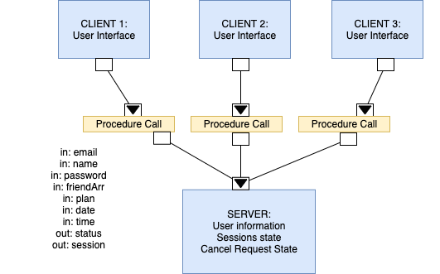

Slide 6
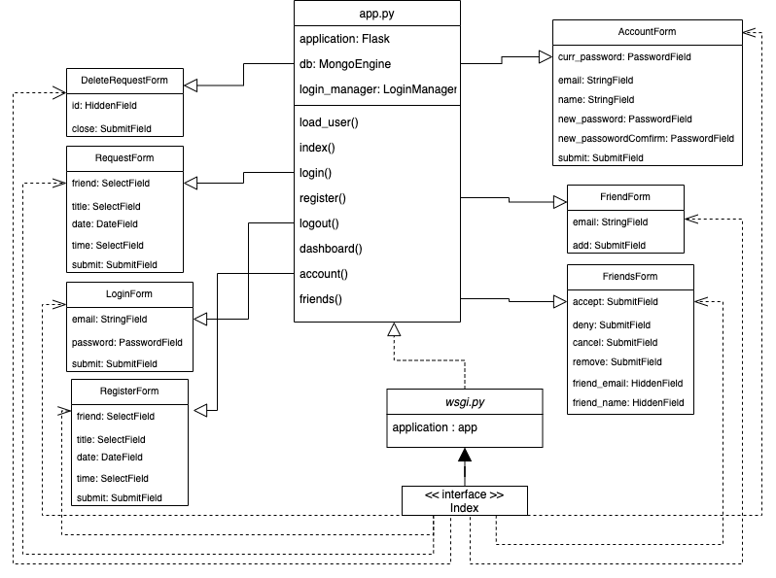
Architecture 1

Slide 7
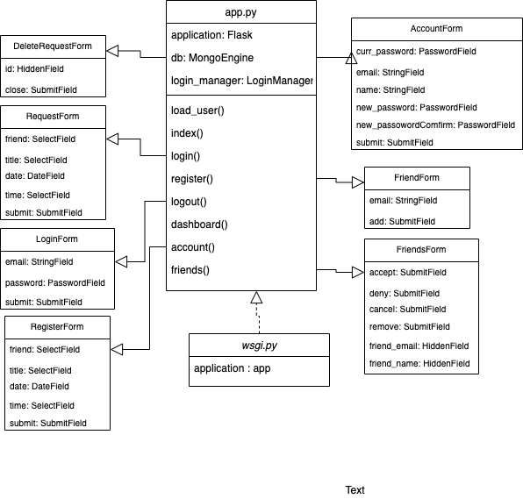

Slide 9
C2 Architecture

Slide 10
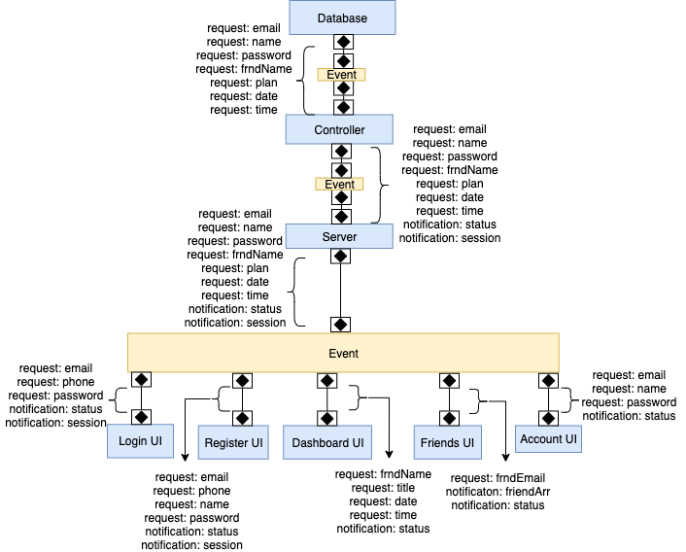

Slide 11
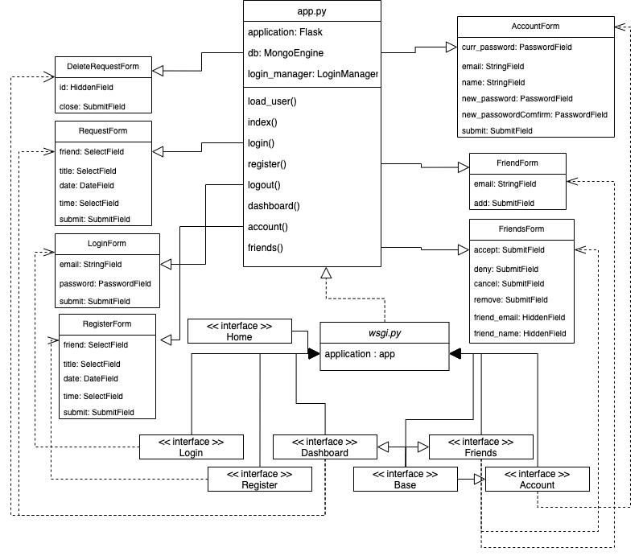
Architecture 1

Slide 13
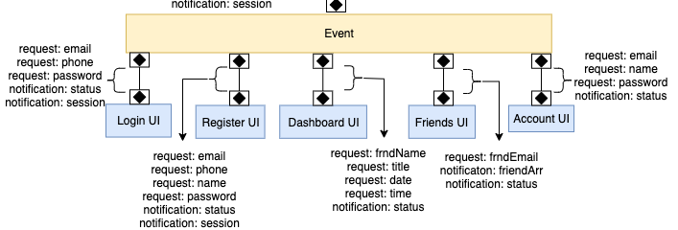

Slide 14
Pros and Cons
Client-Server:
Pros:
Multi-client model assess the importance of security and load-balancing
Cons:
Single-page app: decreased readability
Difficulty editing and expanding upon system
Too abstract does no provide insight to the underlying components and software features
C2:
Pros:
Allows for controlled communication between server and client. Such that the both can communicate based on communication rules
Not as abstract. Components on the client side are defined along with their unique communications.
Separation of components increases editability and reusability
Cons:
Some components are still abstraction
Outside dependencies

Slide 15
Selection
C2 was chosen for its
Division of component into smaller components
Increased readability and reusability
Communication architecture that allows for expendability and future feature additions

Slide 16
Final Architecture
My final architecture was slightly different. During development, the addition of a reverse-proxy was added.
This creates for server abstraction as to increase the security of the system

Slide 17
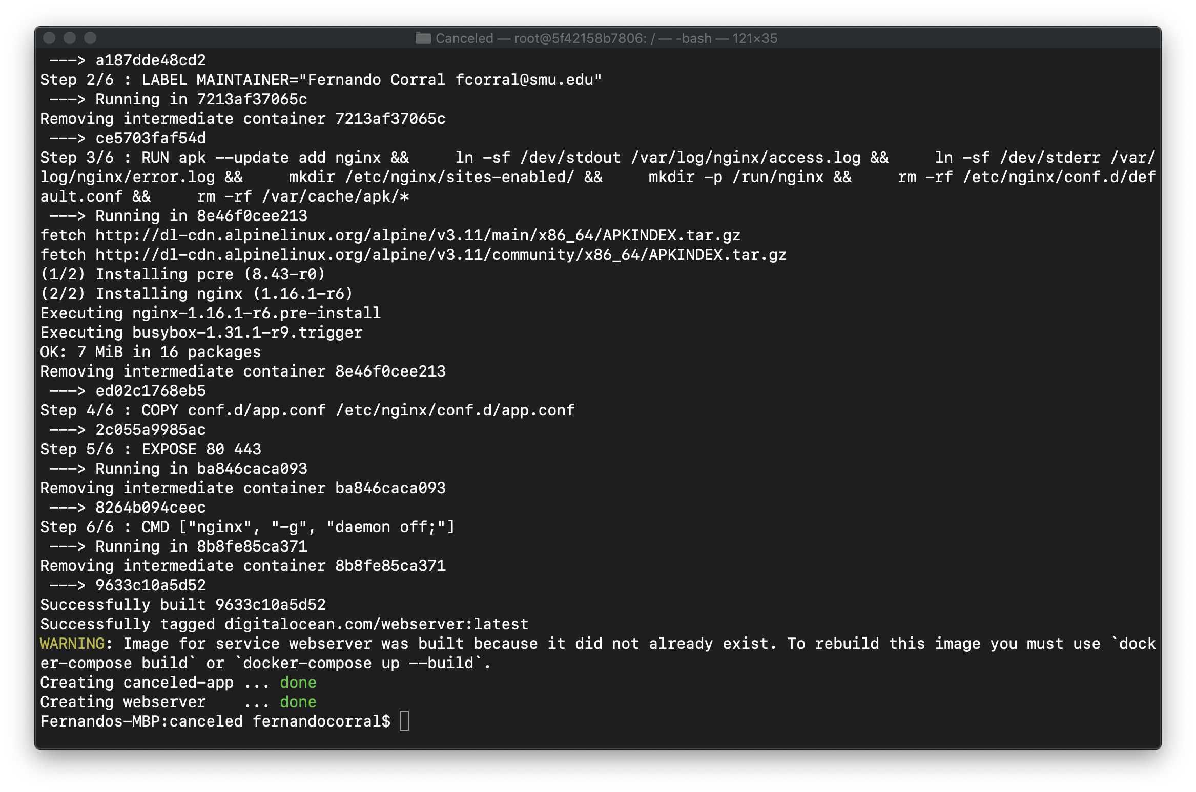
Code Compilation

Slide 18
DeMO

